Slide 1
A hands-on tutorial: Working with Smart Contracts in
Ethereum

Slide 2
Different tools provide different functionality
 | Tools Activities | Remix | Ganache | MyEtherWallet | Geth
1 | Configure the Blockchain | - | - | - | +
2 | Deploy the Blockchain | Not Persistent | + | - | +
3 | Develop the contract | + | - | - | +
4 | Compile the contract | + | - | - | +
5 | Create user account | + | + | + | +
6 | Deploy the contract | + | - | + | +
7 | Create the UI for interacting | + | - | + | +
8 | Run the client | + | - | + | +
9 | Interact with the contract & have fun | + | - | + | +
10 | Monitor the execution | - | + | - | +
1
3
2
4
5
6
8
7
9
https://remix.ethereum.org/ http://truffleframework.com/ganache/ https://github.com/kvhnuke/etherwallet/releases/tag/v3.21.06
10
1

Slide 3

Use which tool for what purpose? (1/2)
Use Geth for everything?
Powerful but command-line only
What should I use?
As a starting point for developing contracts – mostly Remix
What cannot Remix do?
Configure the blockchain
Create real (non-test) user accounts and transfer funds between user accounts
Monitor the execution
Other advanced operations
2

Slide 4
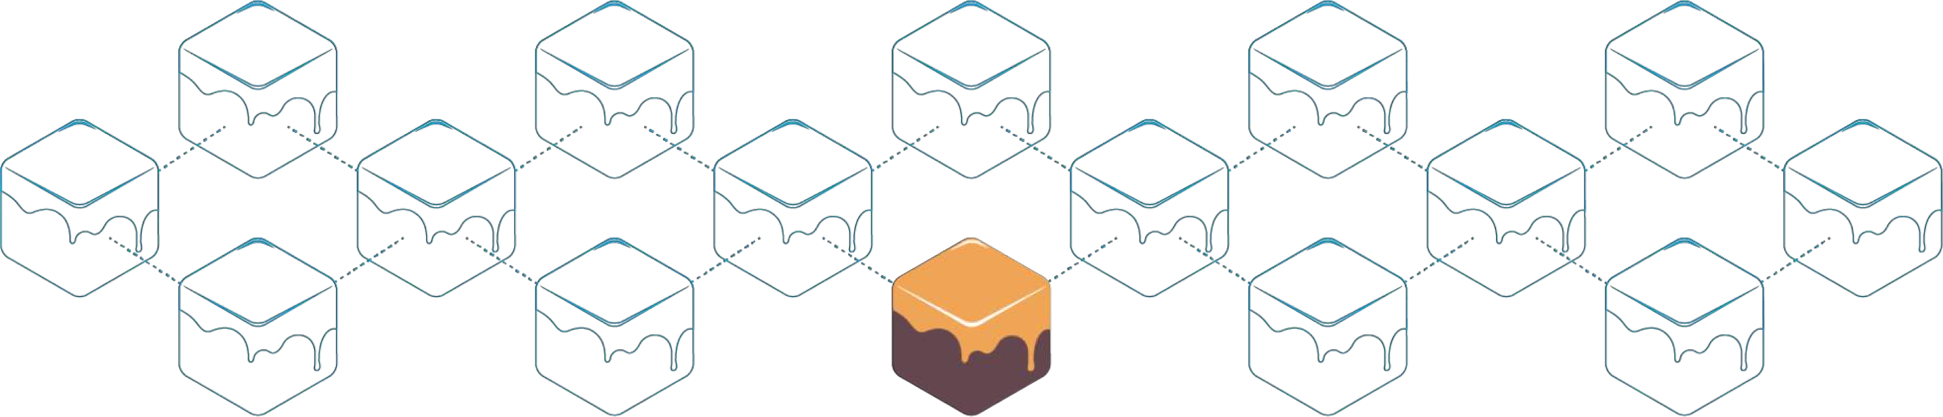
Use which tool for what purpose? (2/2)
Why use Ganache?
To inspect and monitor the execution
To visualize certain elements in a better way
Why use MyEtherWallet?
To create a personal wallet (real user account), transfer funds between user accounts, and interact with contracts
Metamask as another alternative
3

Slide 5

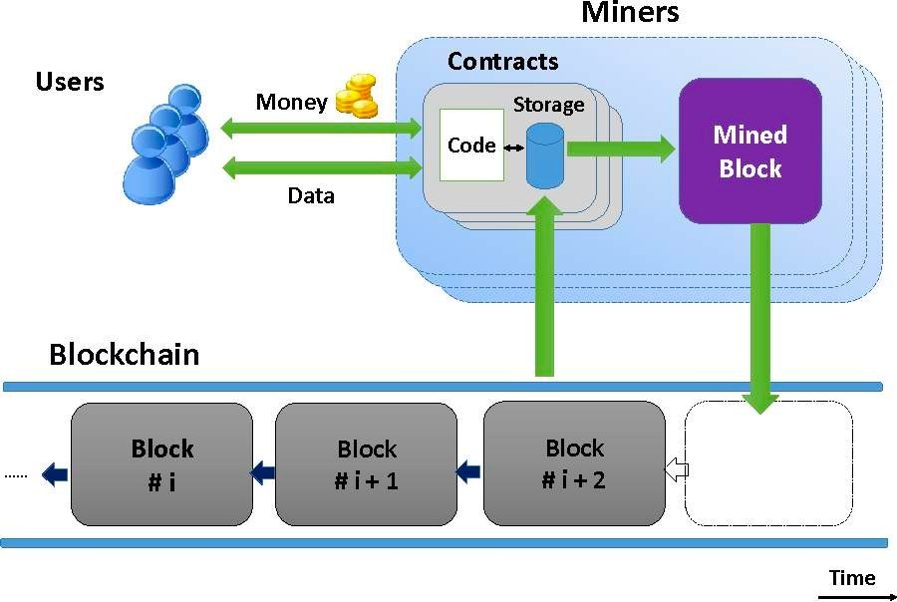
Smart Contracts
In the form of code
Stored on a blockchain
Executes under given conditions
- K. Delmolino, M. Arnett, A. E. Kosba, A. Miller, and E. Shi, “Step by Step Towards Creating a Safe Smart Contract: Lessons and Insights from a Cryptocurrency Lab,” IACR Cryptology ePrint Archive, vol. 2015, p. 460, 2015.
4

Slide 6








Smart Contracts Example (1/3)
Owner creates the contract
Contract replicates among all the nodes
Owner
Blockchain
Create
Contract
Tenant

Slide 7






Smart Contracts Example (2/3)
Tenant deposits to the contract
Contract’s State changes on all the nodes
Owner
Blockchain
Tenant
Deposit

Slide 8

Smart Contracts Example (3/3)
Owner checks the contract’s balance
Contract’s state is fetched from one node
Owner
Blockchain
Check Balance
Tenant

Slide 9
Smart Contracts
Developing a simple contract
Compiling the contract
Deploying the contract
Interacting with the contract
Adding more functions to our code to make it more practical

Slide 10

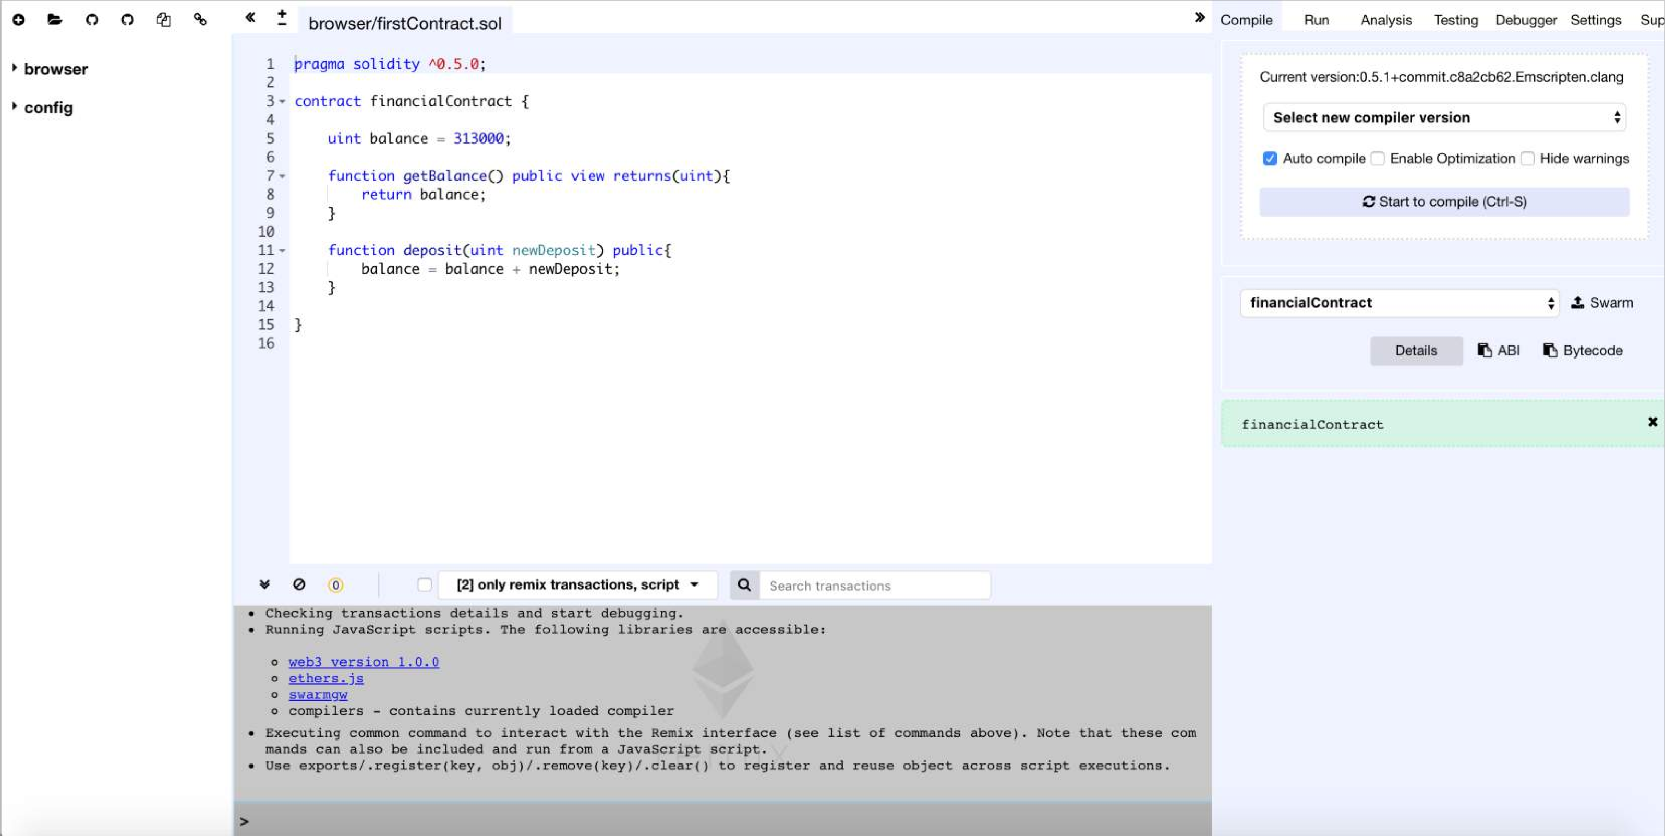
Open Remix : remix.ethereum.org
An open source tool for writing, compiling and testing Solidity contracts

Slide 11

Solidity
Object-oriented
Contract-oriented
High-level language
Influenced by C++, Python, and JavaScript
Target Ethereum Virtual Machine (EVM)
Serpent as an Alternative?
Low-level language
Complex compiler

Slide 12

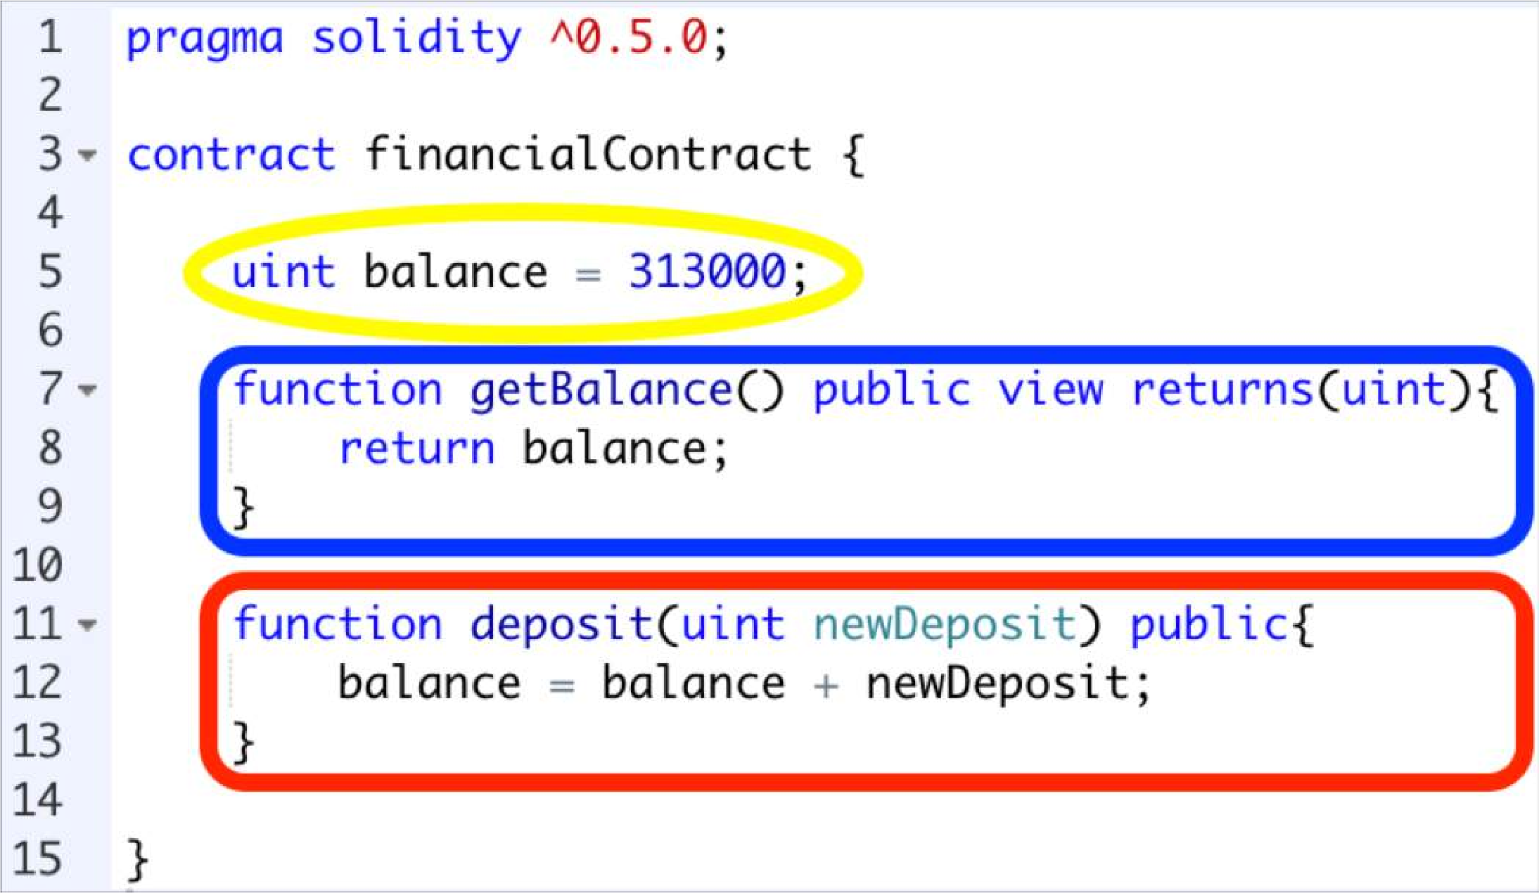
Start Coding
Setter and Getter: Set and get the information.
Variable
Getter function
Setter function

Slide 13

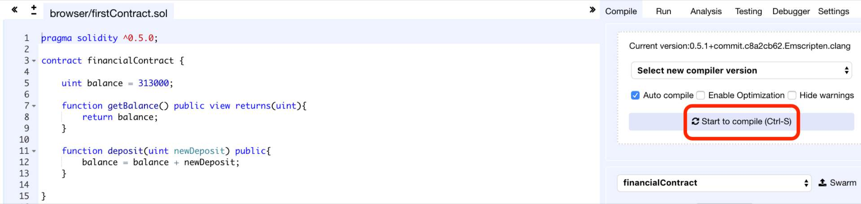
Compile the Contract
Compile tab: Start to compile button

Slide 14

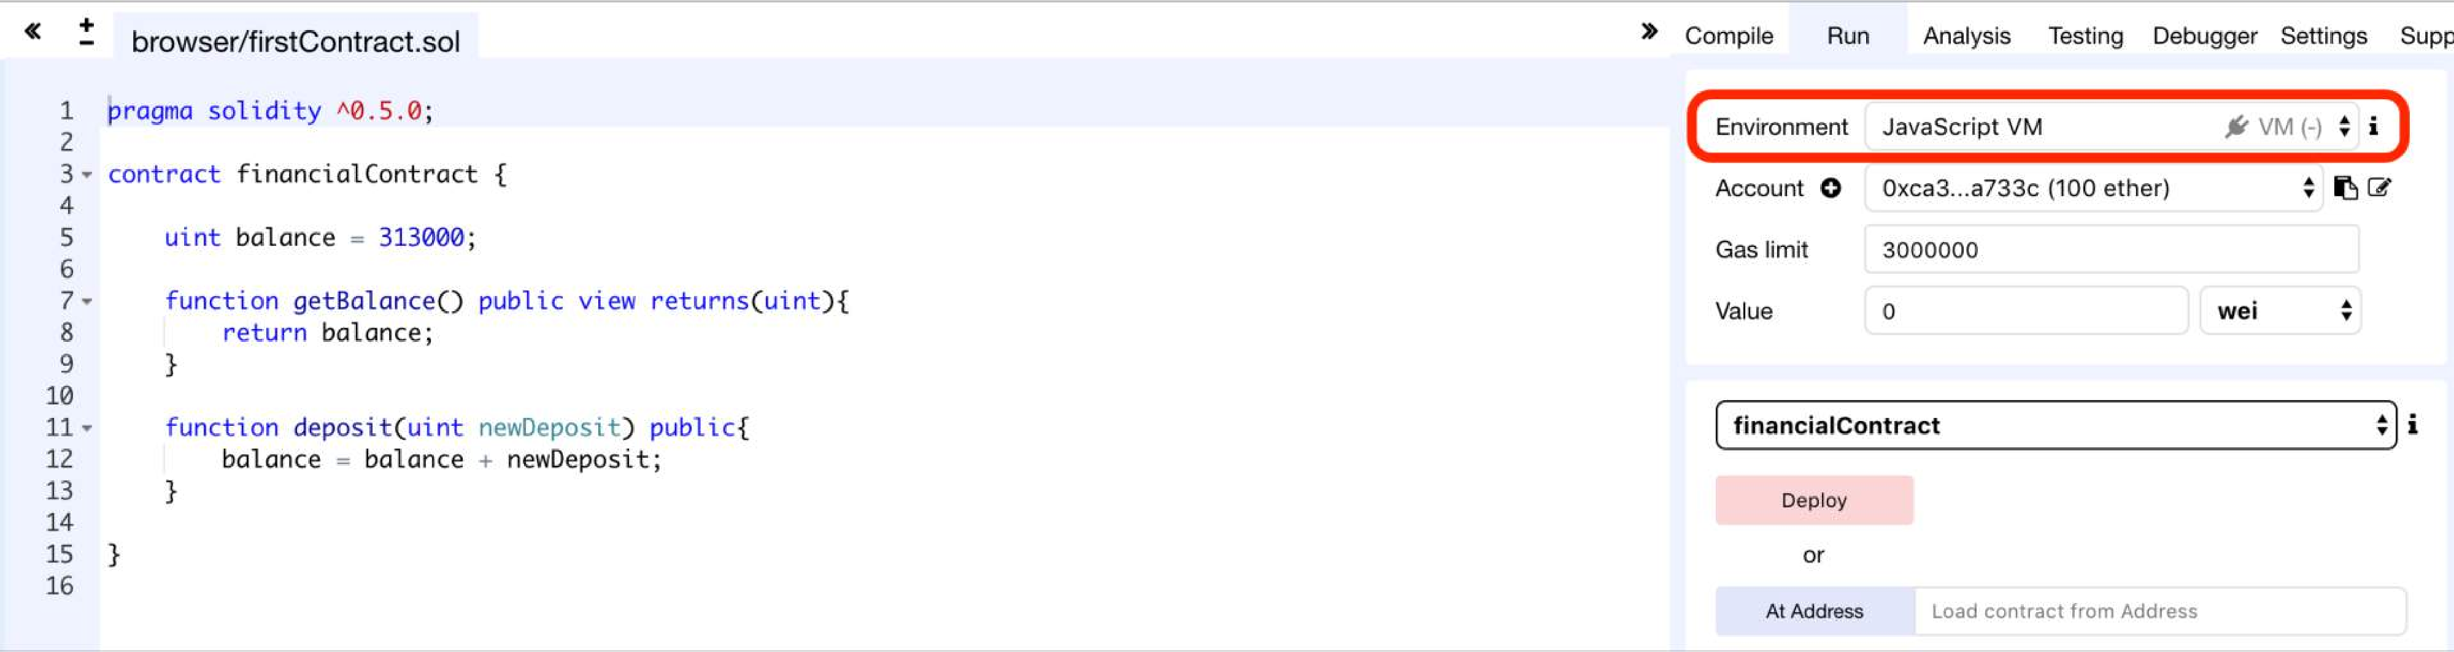
Set Deployment Parameters (1/2)
Run tab: Environment = JavaScript VM

Slide 15
Set Deployment Parameters (2/2)
JavaScript VM: All the transactions will be executed in a sandbox blockchain in the browser. Nothing will be persisted and a page reload will restart a new blockchain from scratch, the old one will not be saved.
Injected Provider: Remix will connect to an injected web3 provider. Mist and Metamask are example of providers that inject web3, thus they can be used with this option.
Web3 Provider: Remix will connect to a remote node. You will need to provide the URL address to the selected provider: geth, parity or any Ethereum client.
Gas Limit: The maximum amount of gas that can be set for all the instructions of a contract.
Value: Input some ether with the next created transaction (wei = 10⁻¹⁸ of ether).

Slide 16
Types of Blockchain Deployment
Private: e.g., Ganache sets a personal Ethereum blockchain for running tests, executing commands, and inspecting the state while controlling how the chain operates.
Public Test (Testnet): Like Ropsten, Kovan and Rinkeby which are existing public blockchains used for testing and which do not use real funds. Use faucet for receiving initial virtual funds.
Public Real (Mainnet): Like Bitcoin and Ethereum which are used for real and which available for everybody to join.

Slide 17

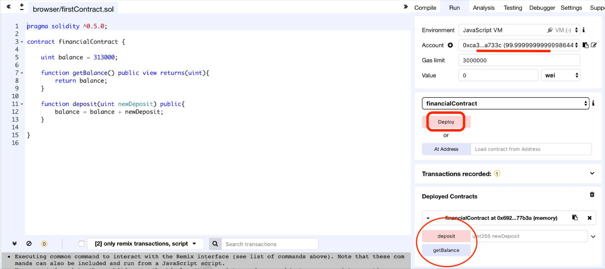
Deploy the Contract on the Private Blockchain of Remix
Run tab: Deploy button

Slide 18

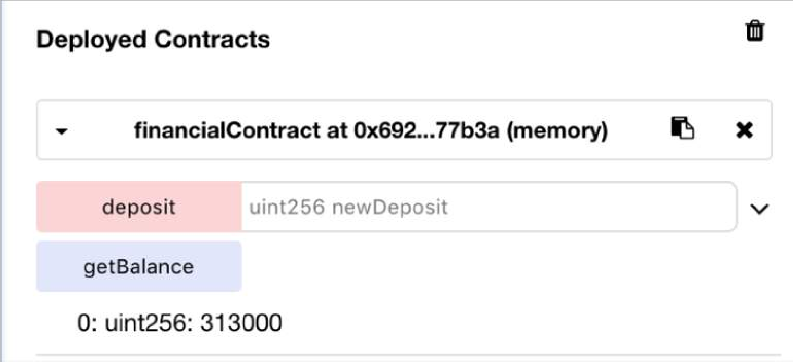

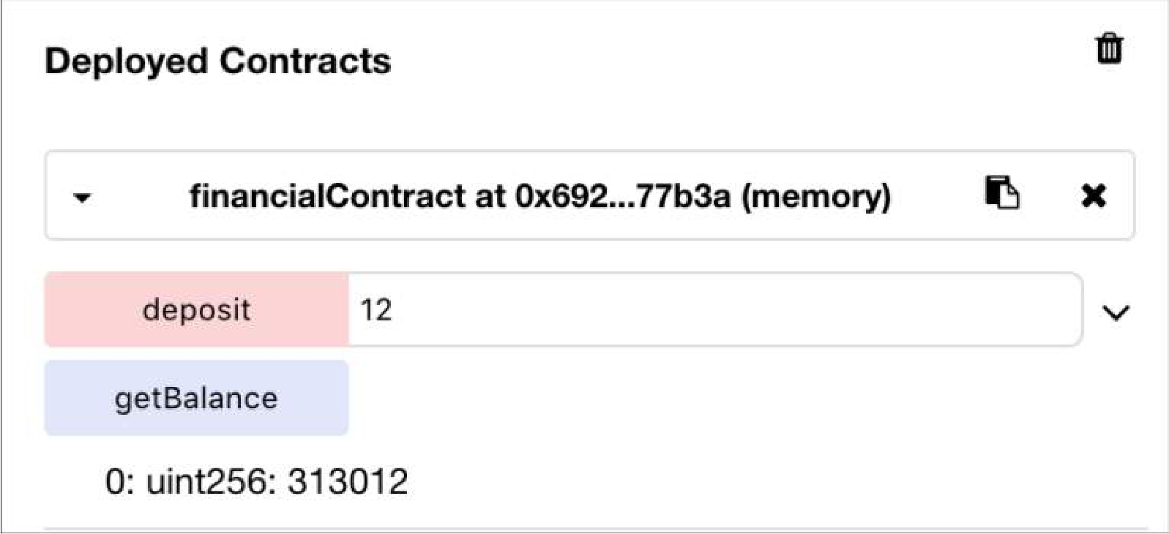
Interact with the Contract
Setter = Red Button: Creates transaction
Getter= Blue Button: Just gives information
Press getBalance to see the initial amount
1
Input a value and press deposit button to create and confirm the transaction
2
Press getBalance again to see the result
3

Slide 19
Additional features
Transferring funds from an account to the contract
Saving the address of the contract creator
Limiting the users’ access to functions
Withdrawing funds from the contract to an account

Slide 20

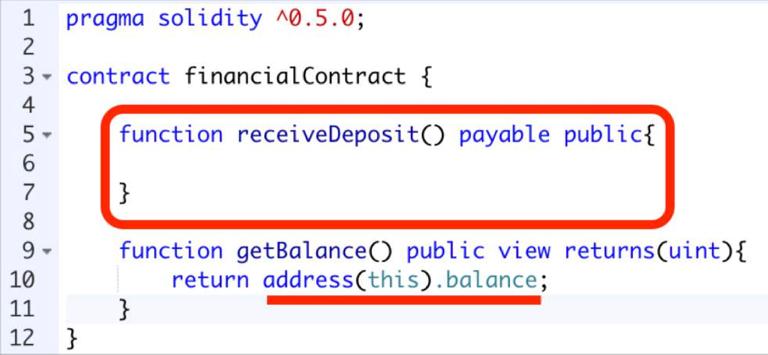
Receive ether (1/2)
Transfer money to the contract
Payable keyword allows receiving ether
Hidden Code:
Address(this).balance += msg.value;
We can get the balance of the contract
19

Slide 21

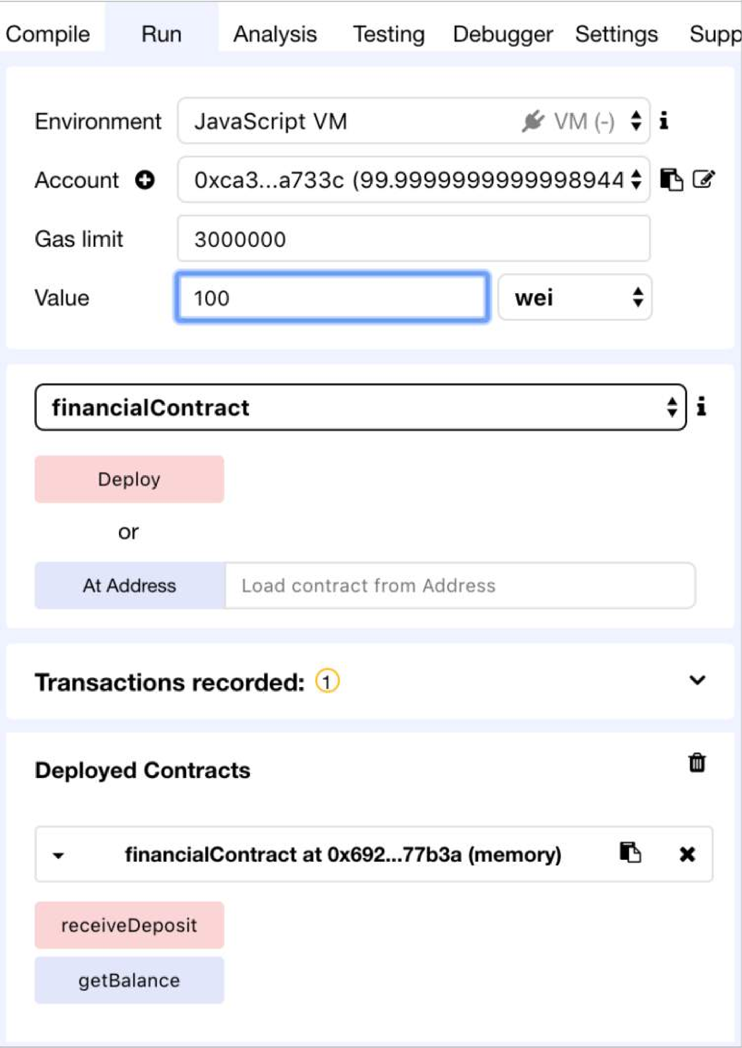
Receive ether (2/2)
Input the value as wei (10⁻¹⁸ of ether)
1
Click the receiveDeposit button to transfer the money to the contract
2

Slide 22

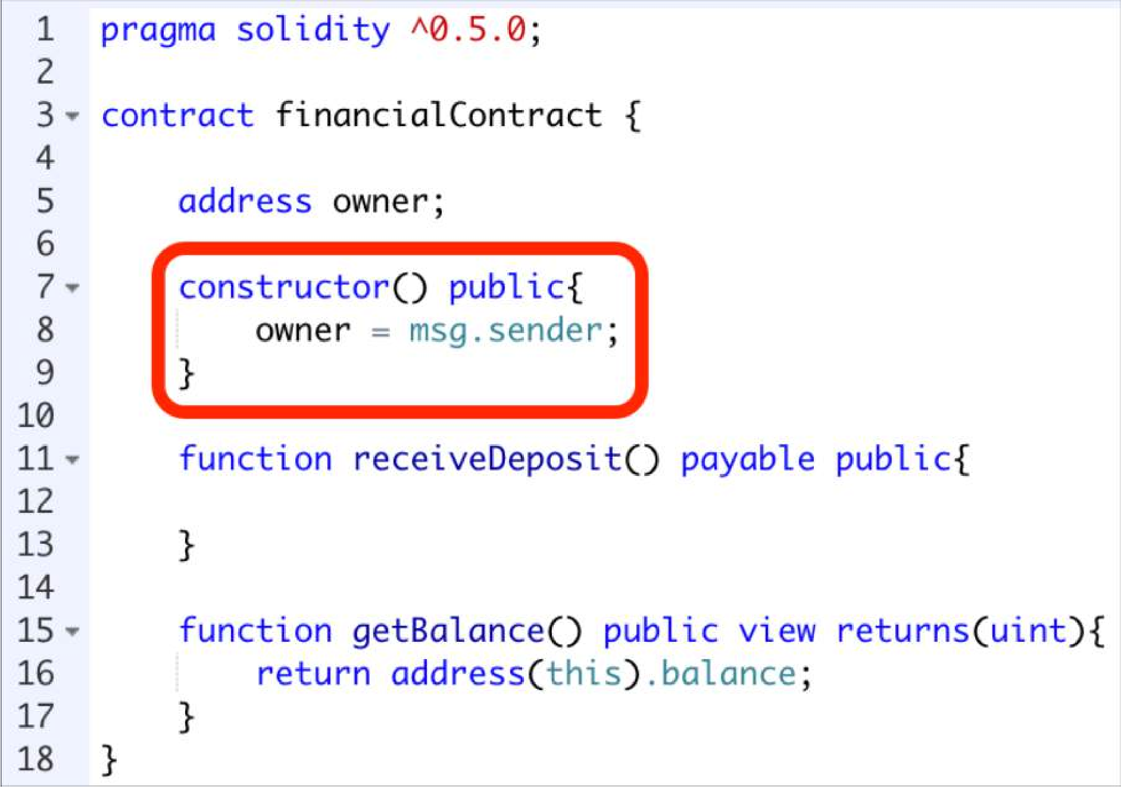
Constructor
Will be called at the creation of the instance of the contract
We want to save the address of the contract creator

Slide 23

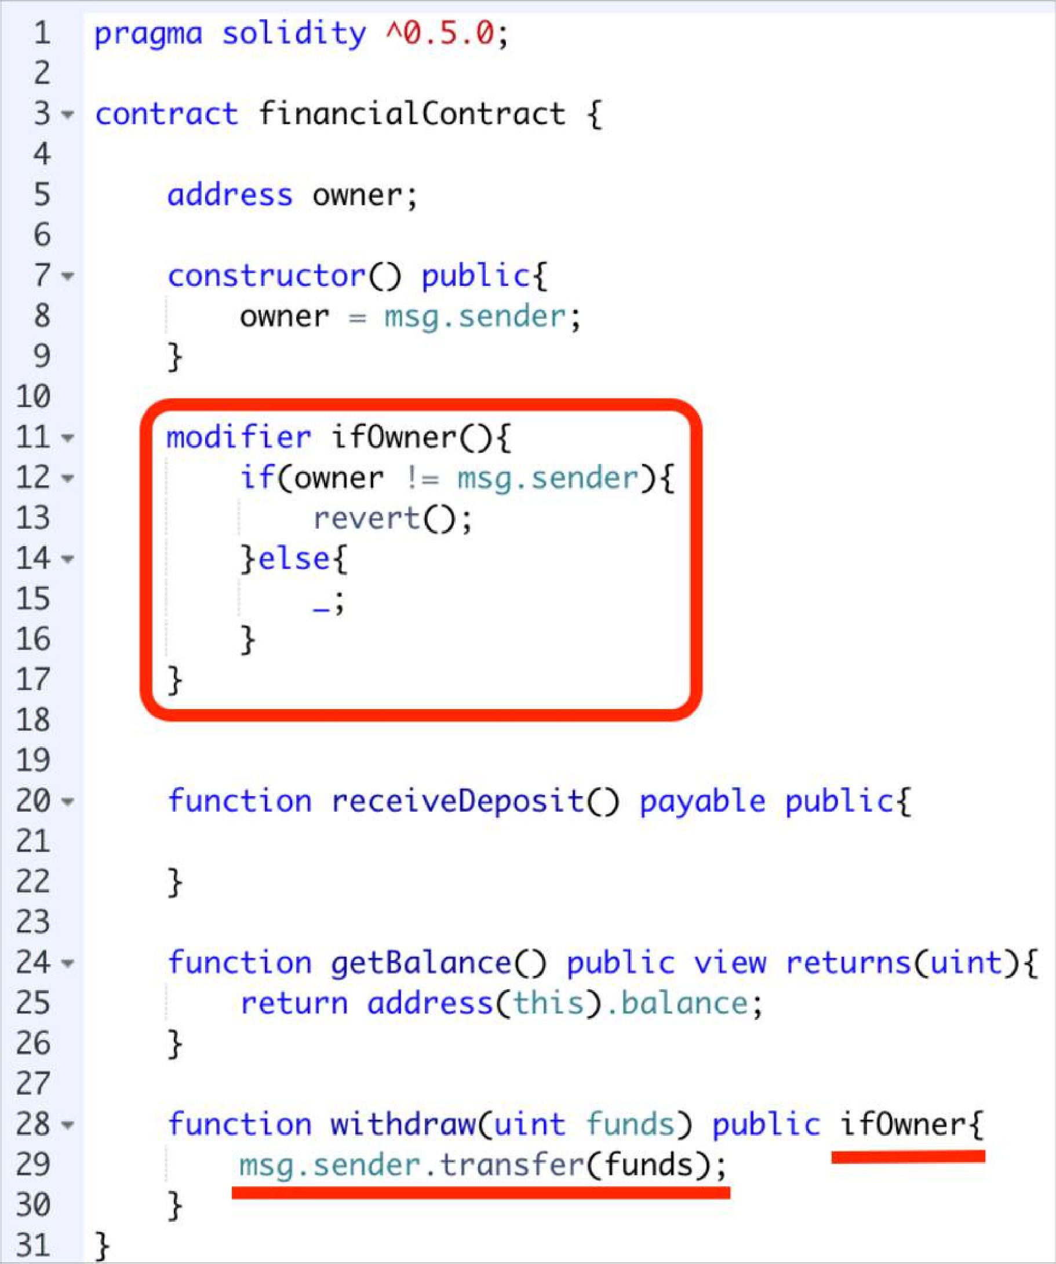
Withdraw funds
Modifier: Conditions you want to test in other functions
First the modifier will execute, then the invoked function
Only the contract’s creator is permitted to withdraw
Transfer some money from the contract’s balance to the owner

Slide 24
Now deploying a smart contract on an external blockchain
 | Tools Activities | Remix | Ganache | MyEtherWallet | Geth
1 | Configuring the Blockchain | - | - | - | +
2 | Deploying the Blockchain | Not Persistent | + | - | +
3 | Developing the contract | + | - | - | +
4 | Compiling the contract | + | - | - | +
5 | Creating user account | + | + | + | +
6 | Deploying the contract | + | - | + | +
7 | Creating the UI for interacting | + | - | + | +
8 | Run the client | + | - | + | +
9 | Interact with the contract & have fun | + | - | + | +
10 | Monitoring the execution | - | + | - | +

Slide 25

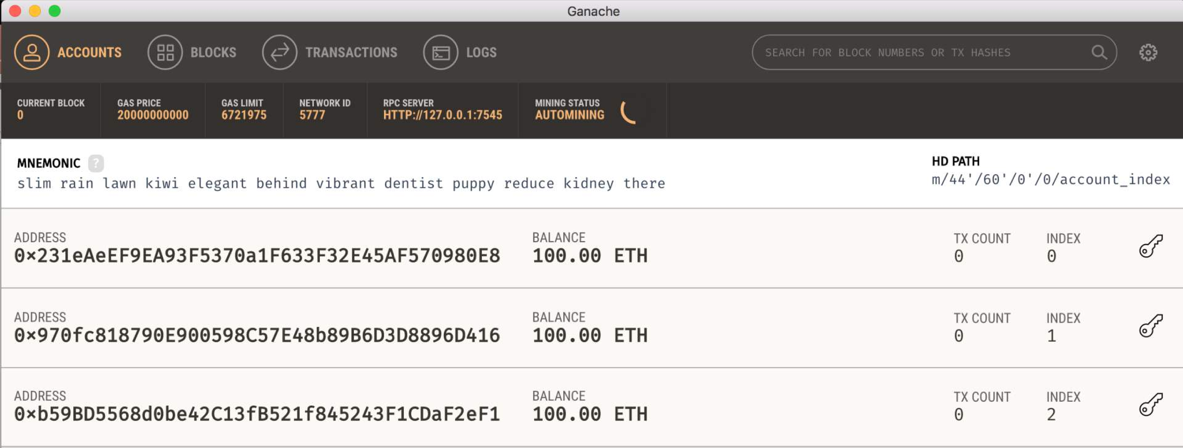
Run Ganache

Slide 26

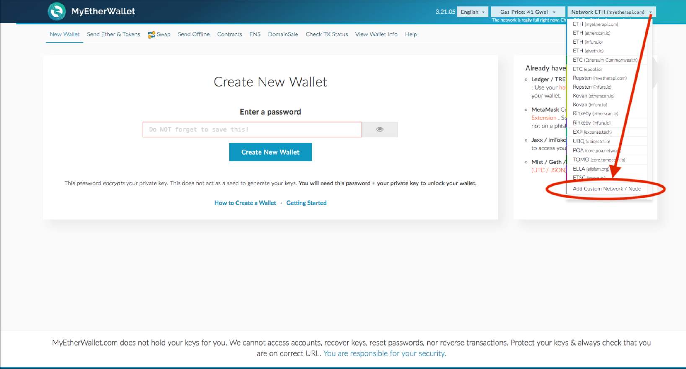
MyEtherWallet
add your custom network that you want to test your contracts on

Slide 27

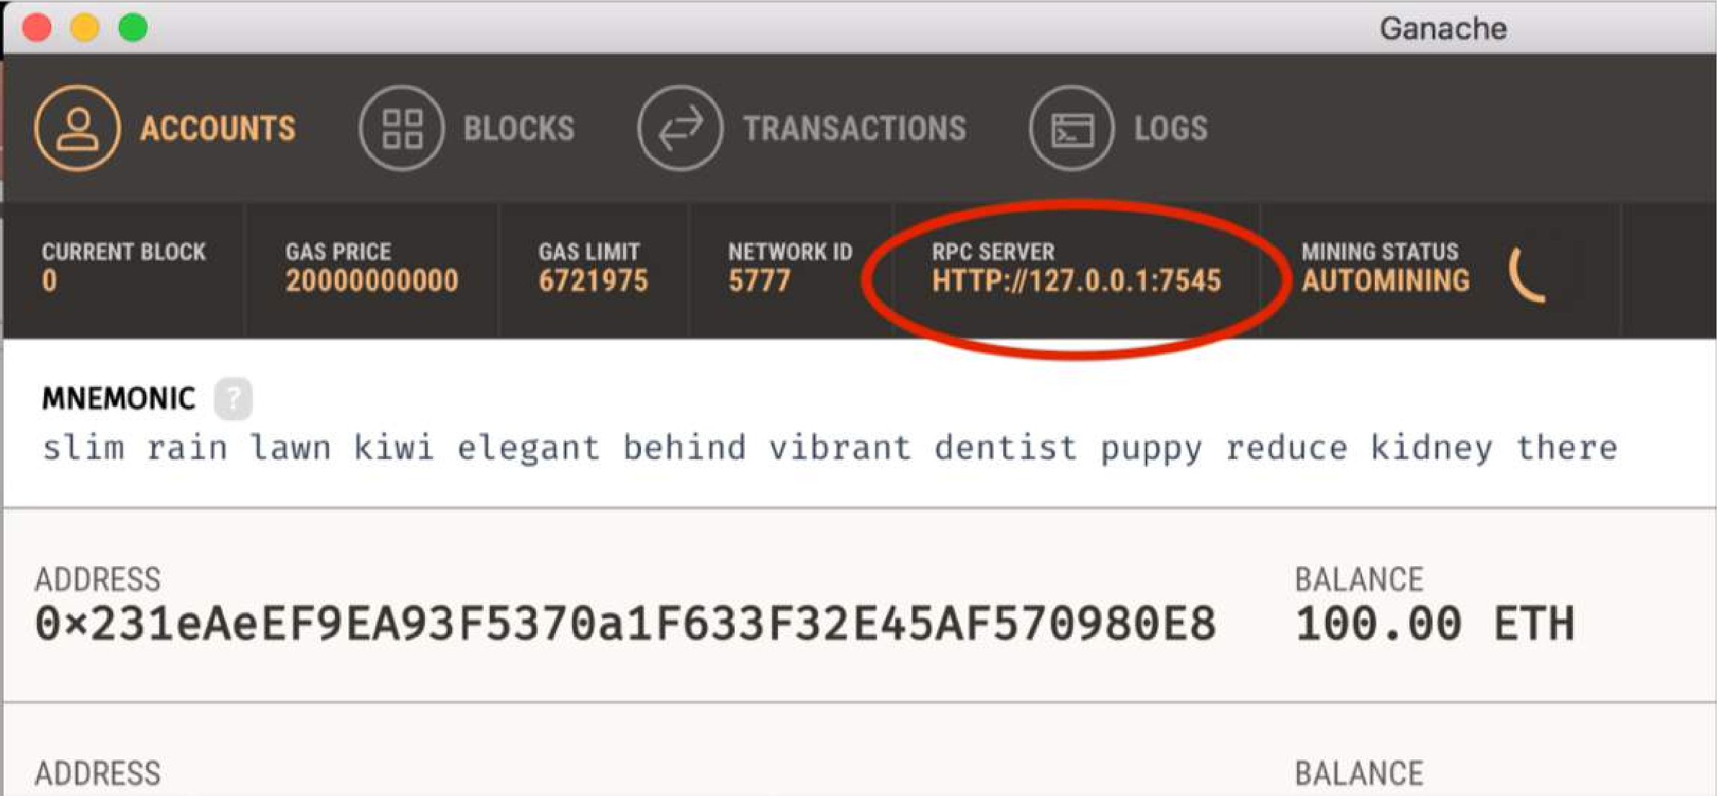

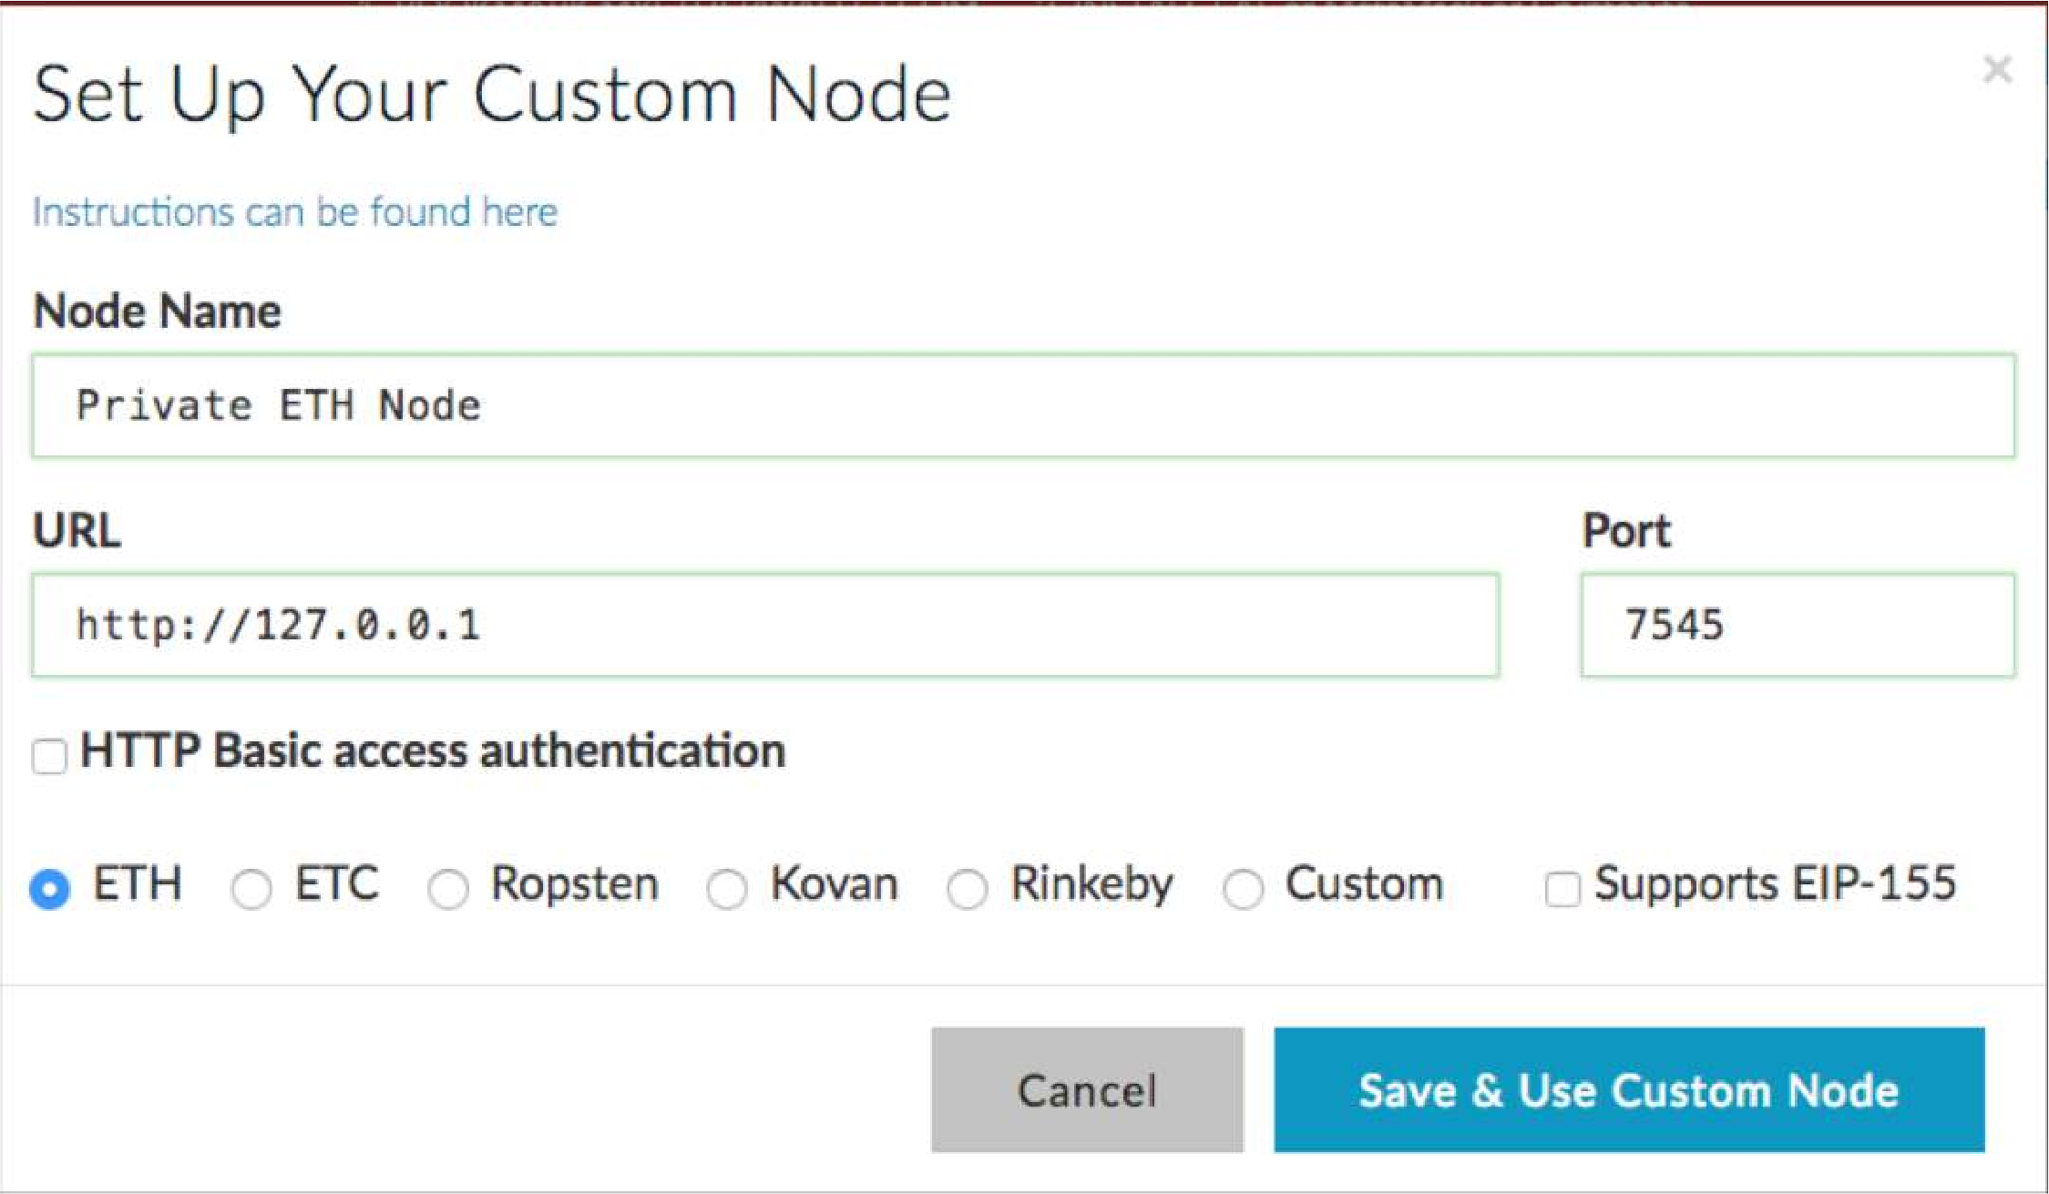
Import your RPC server address and the port number from Ganache to MyEtherWallet

Slide 28

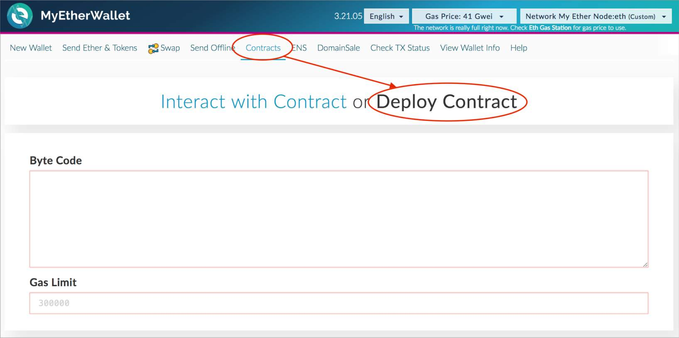
MyEtherWallet
Contracts tab: Deploy Contract

Slide 29
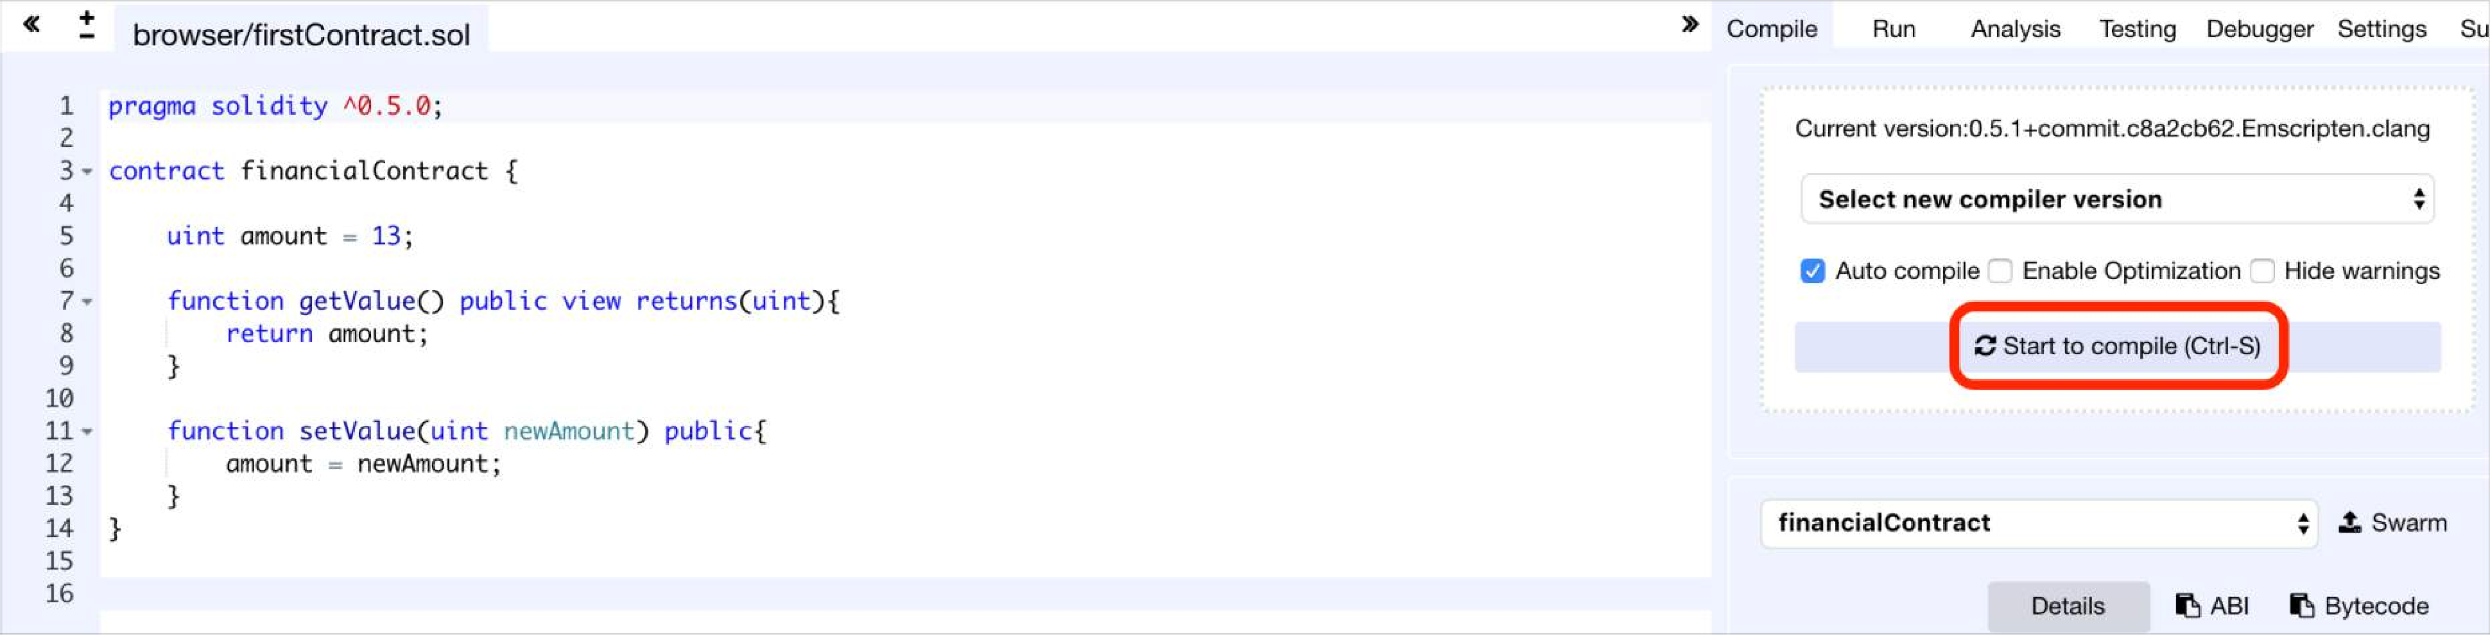
Remix
Type your contract and compile it

Slide 30
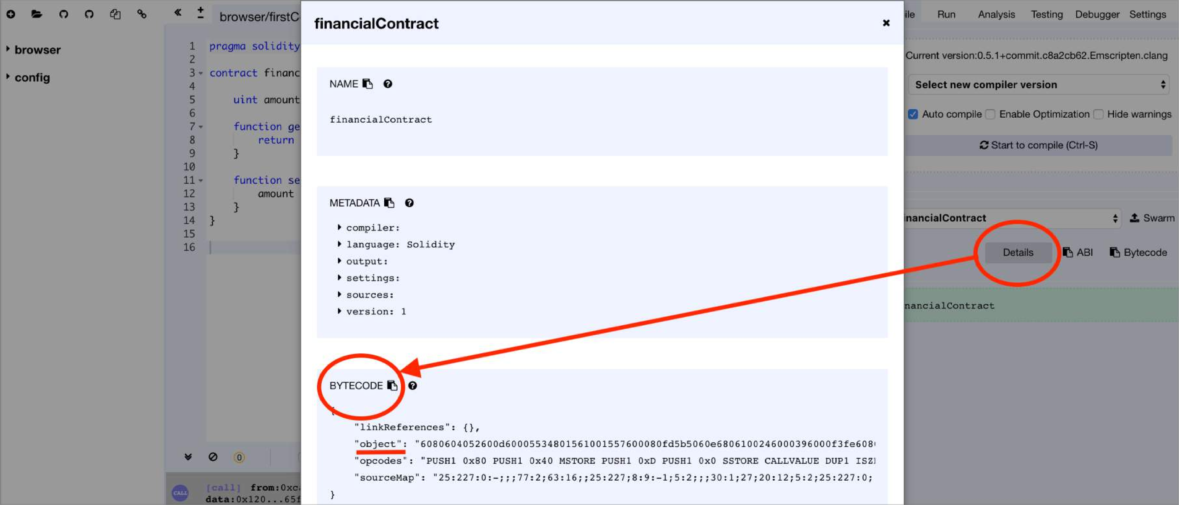
Remix
Click on Details Button: access ByteCode to import it to MyEtherWallet

Slide 31

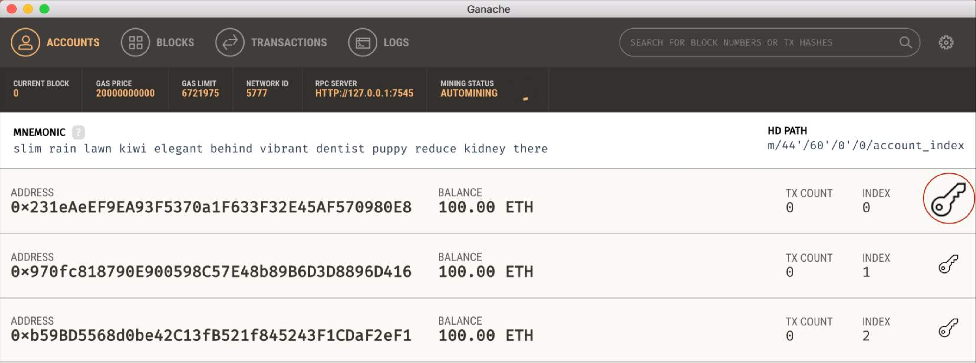

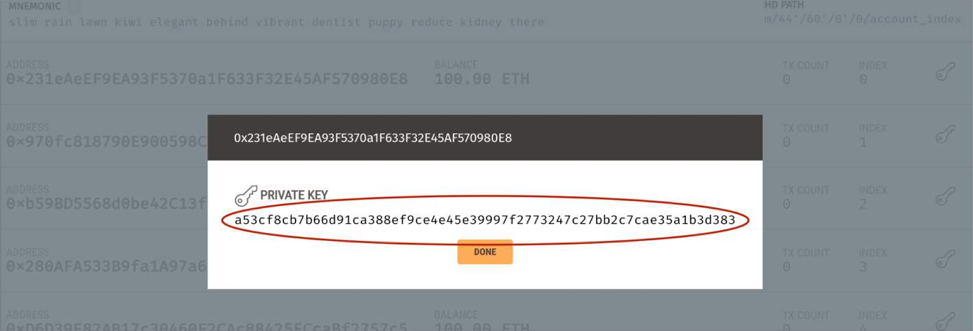
Ganache
Access your private key for signing your contract in MyEtherWallet.

Slide 32

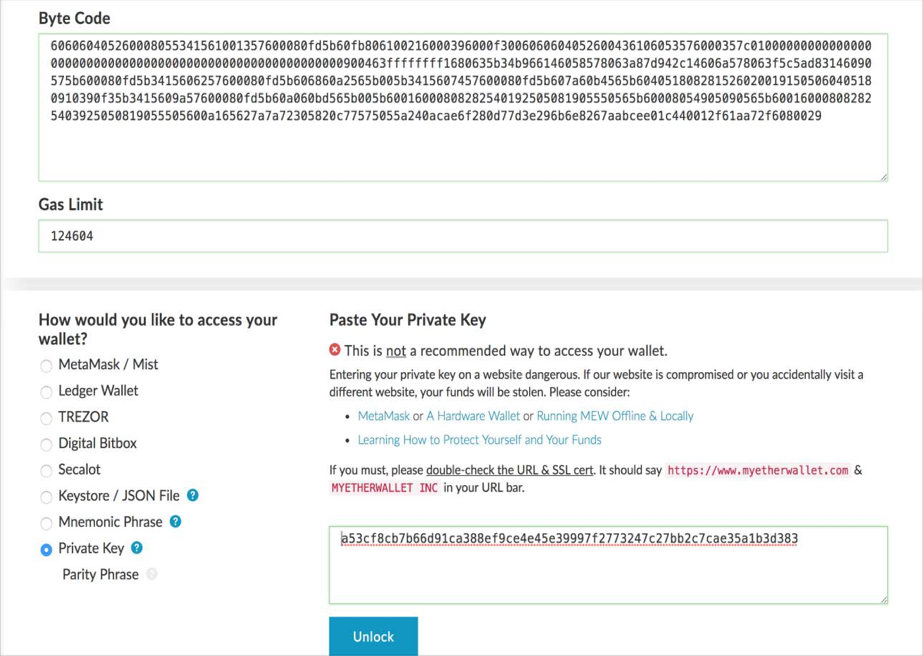
MyEtherWallet
Paste the contract’s ByteCode from Remix
Gas Limit will automatically be calculated
Paste your private key from Ganache
Click Unlock
Now you have access to your wallet
31

Slide 33

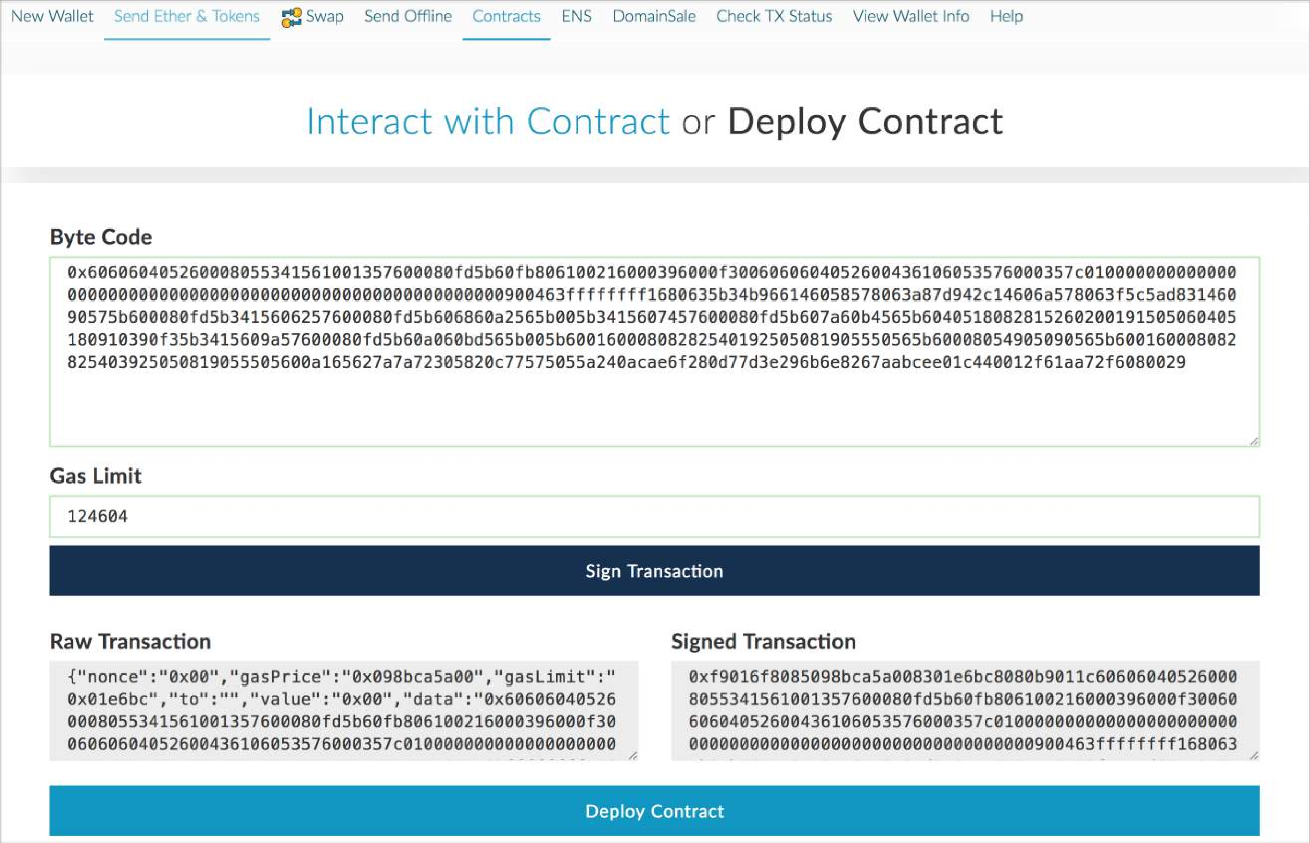
MyEtherWallet
Click on Sign Transaction button to deploy your contract

Slide 34

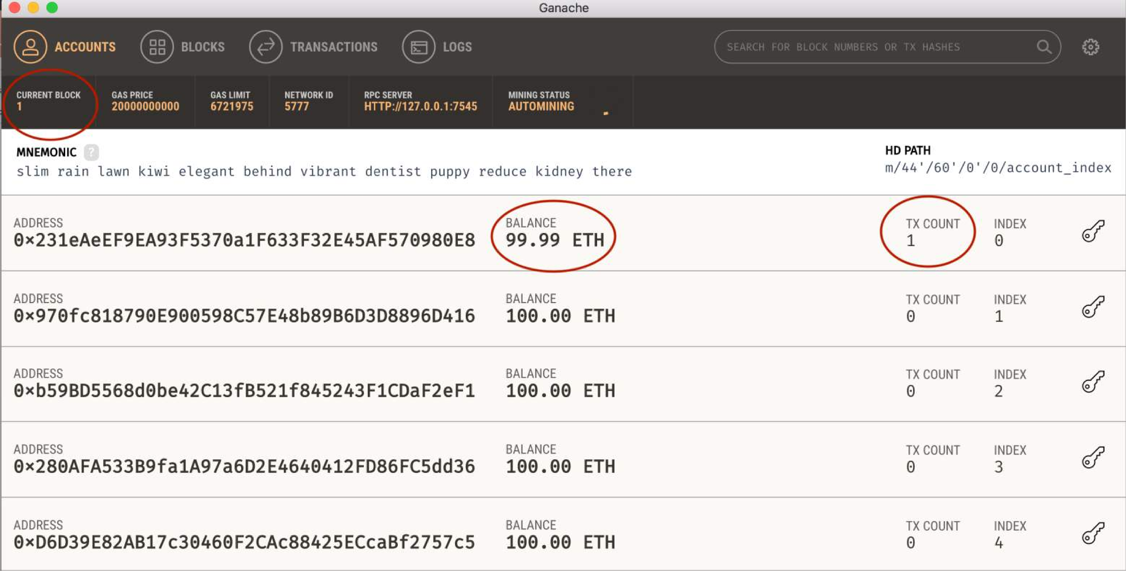
Ganache
You can see now you have one transaction for your address and your balance has been changed because of the amount of gas you paid for creating the contract.

Slide 35
Example Account
Private Key:
0x2dcef1bfb03d6a950f91c573616cdd778d9581690db1cc43141f7cca06fd08ee
Ethereum Private keys are 66 character strings (with 0x appended). Case is irrelevant. Same derivation through ECDSA as BTC.
Address:
0xA6fA5e50da698F6E4128994a4c1ED345E98Df50
Ethereum Private keys map to addresses directly. Simply the last 40 characters of the Keccak-256 hash of the public key. Address is 42 characters total (append 0x to front).

Slide 36
Transactions
A request to modify the state of the blockchain
Can run code (contracts) which change global state
Contrasts only balance updates in BTC
Signed by originating account
Types:
Send value from one account to another account
Create smart contract
Execute smart contract code

Slide 37
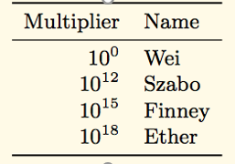
Ether Denominations
Wei - lowest denomination
Named after Wei Dai - author of b-money paper (1998), many core concepts used in BTC implementation
1/1,000,000,000,000,000,000 (quintillion)
Szabo - next denomination
Named after Nick Szabo - author of Bit-Gold
Finney – 2nd highest denomination
Named after Hal Finney - received first Tx from Nakamoto
http://www.weidai.com/bmoney.txt

Slide 38
Smart Contracts
Executable code
Turing Complete
Function like an external account
Hold funds
Can interact with other accounts and smart contracts
Contain code
Can be called through transactions

Slide 39
Code Execution
Every node contains a virtual machine (similar to Java)
Called the Ethereum Virtual Machine (EVM)
Compiles code from high-level language to bytecode
Executes smart contract code and broadcasts state
Every full-node on the blockchain processes every transaction and stores the entire state

Slide 40
Gas
Halting problem (infinite loop) – reason for Gas
Problem: Cannot tell whether or not a program will run infinitely from compiled code
Solution: charge fee per computational step to limit infinite loops and stop flawed code from executing
Every transaction needs to specify an estimate of the amount of gas it will spend
Essentially a measure of how much one is willing to spend on a transaction, even if buggy

Slide 41
Gas Cost
Gas Price: current market price of a unit of Gas (in Wei)
Check gas price here: https://ethgasstation.info/
Is always set before a transaction by user
Gas Limit: maximum amount of Gas user is willing to spend
Helps to regulate load on network
Gas Cost (used when sending transactions) is calculated by gasLimit*gasPrice.
All blocks have a Gas Limit (maximum Gas each block can use)

Slide 42
Interacting with the smart contract
Extract the contract address from Ganache
Extract the ABI (Application Binary Interface) of the code from Remix
Interact with the contract in MyEtherWallet
(Import the contract address and the ABI into the MyEtherWallet)
Select a function
Write
Pay some gas
Read
Generate the transaction
Receive the result

Slide 43

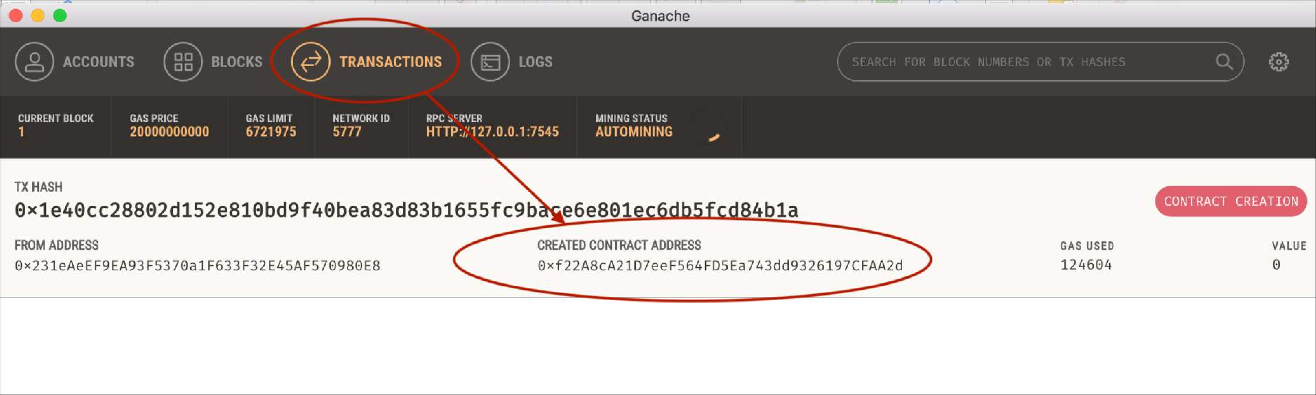
Ganache
Transactions tab: Copy the created contract address

Slide 44

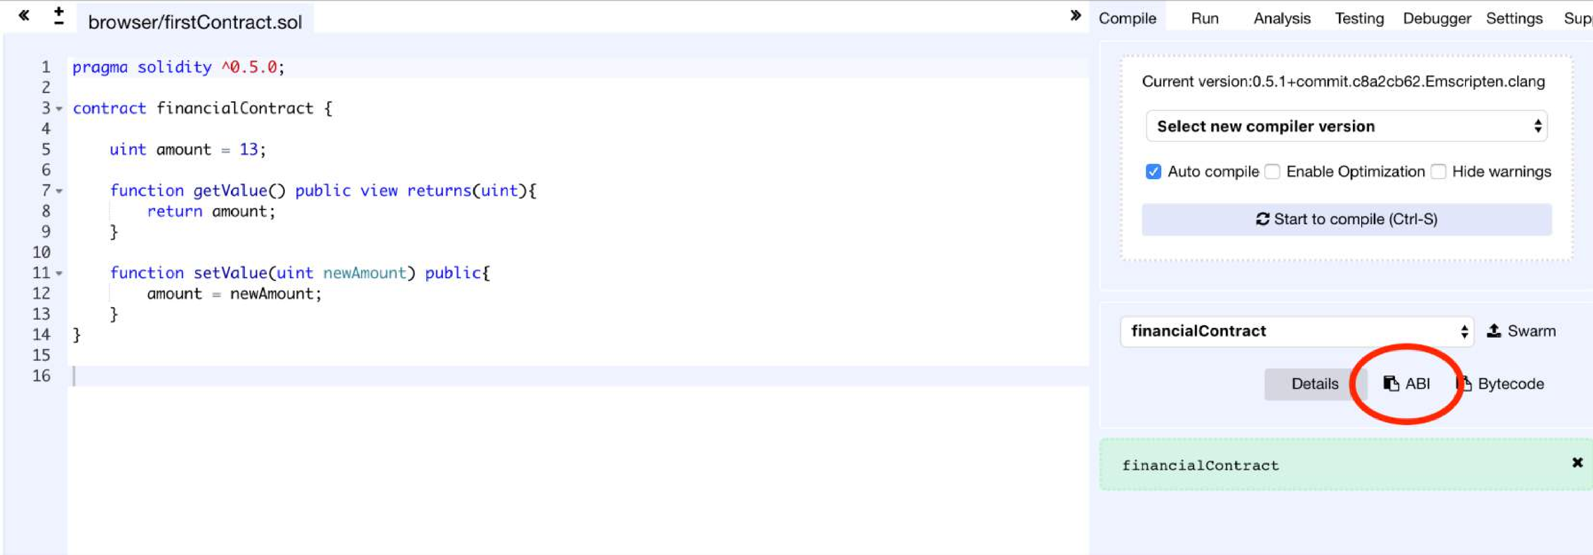
Remix
Copy the ABI
(ABI is the interface that tells MyEtherWallet how to interact with the contract)

Slide 45

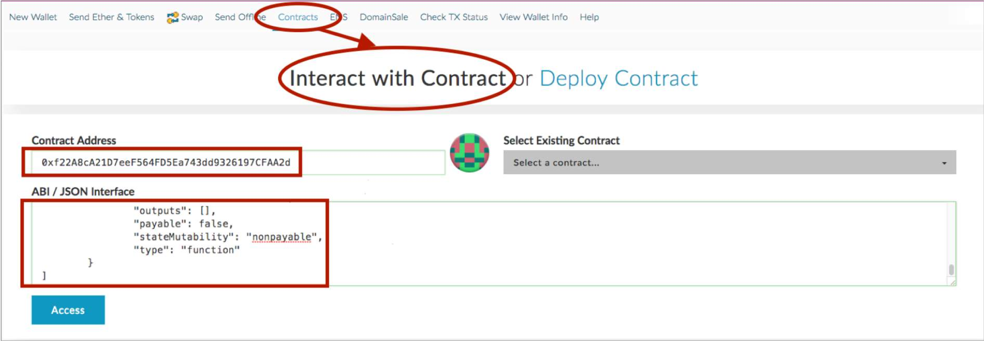
MyEtherWallet
Contracts tab:
Interact with Contract = Paste the contract address from Ganache and the ABI from Remix

Slide 46

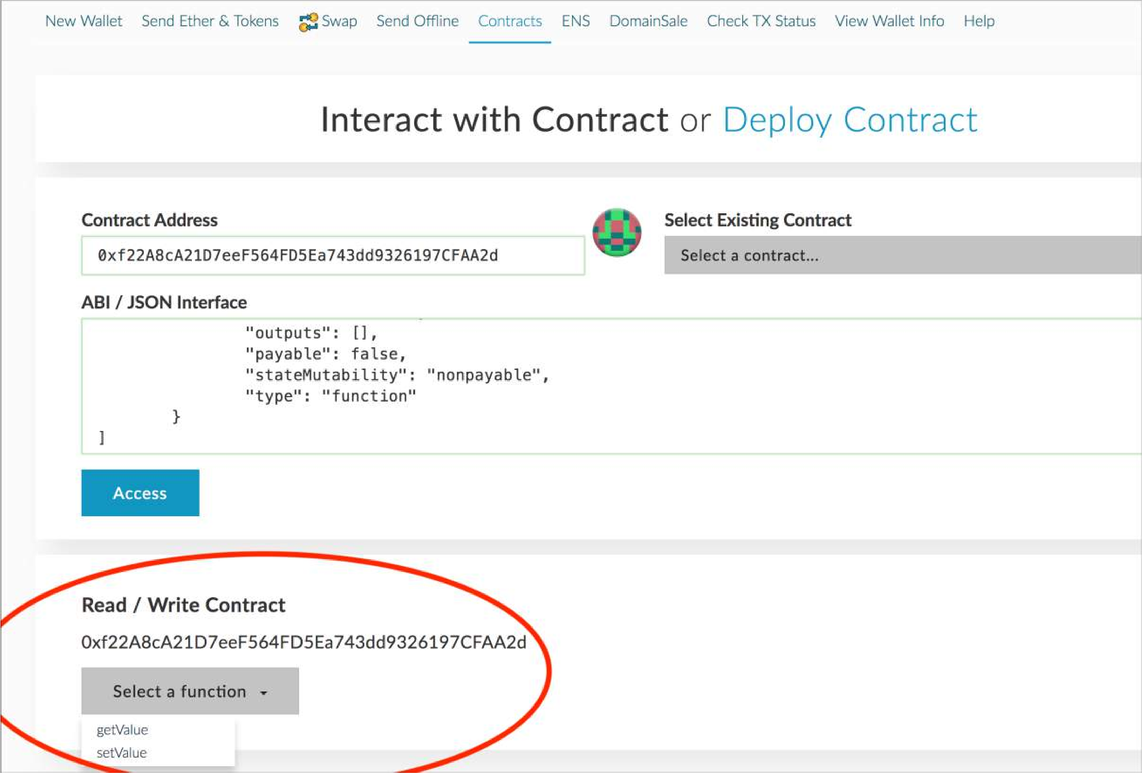
MyEtherWallet
You now can interact with the contract by selecting a function and invoking it

Slide 47

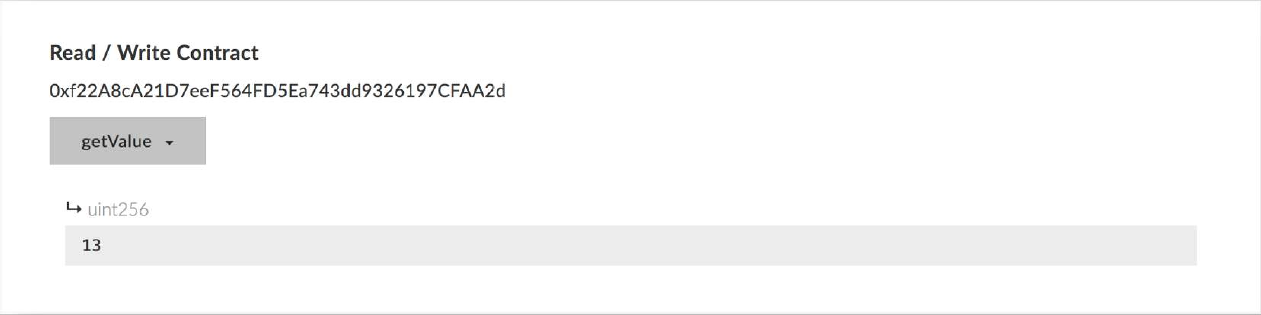
MyEtherWallet
If you select the getValue function you will receive the value without paying any gas
(There is no operation cost for getting information)

Slide 48


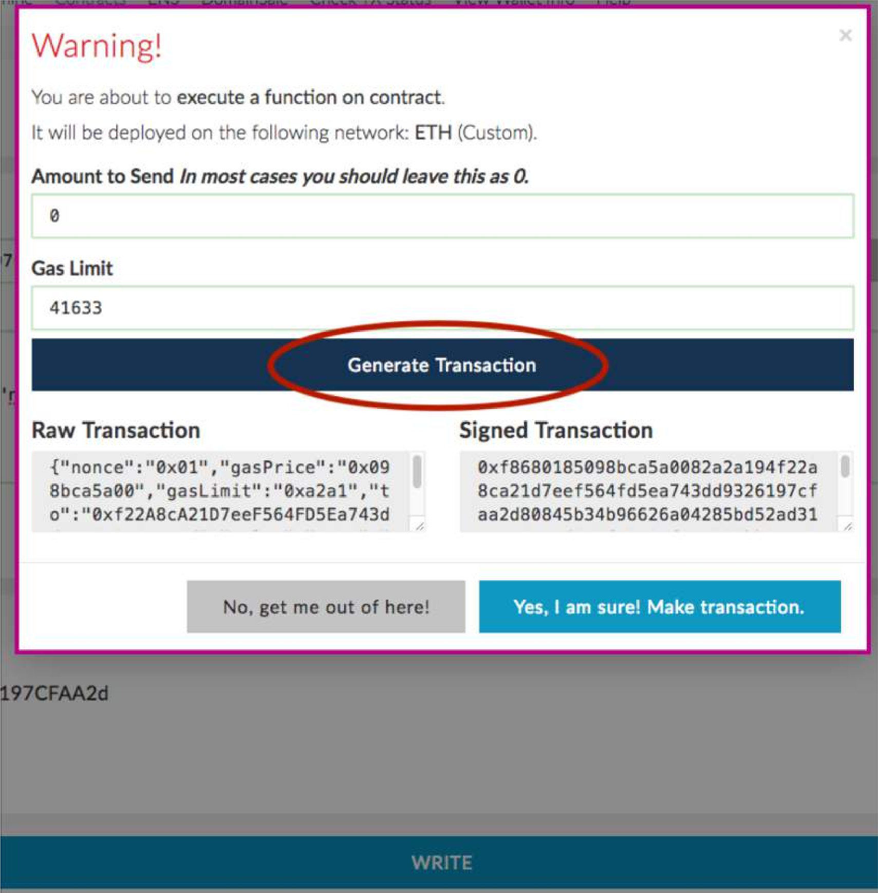
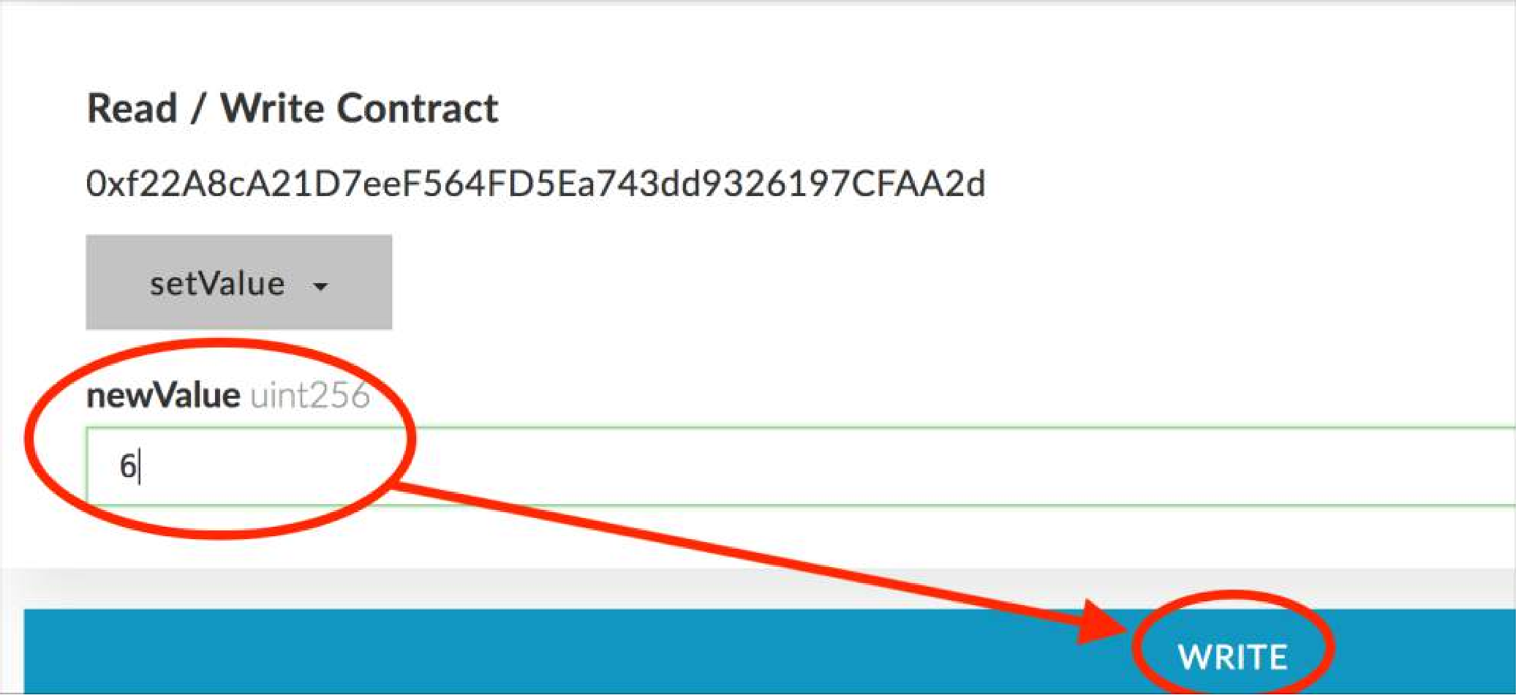
MyEtherWallet
If you choose a function that updates the state of the contract, you will need to pay gas for it in a transaction.

Slide 49
Create Custom Ethereum Blockchain
Instead of using Ganache with its default properties for private blockchain you can run your own blockchain
Install Geth: One of the implementations of Ethereum written in Go
Create the genesis block
Create storage of the blockchain
Deploy blockchain nodes
Connect MyEtherWallet to your blockchain to interact with it

Slide 50
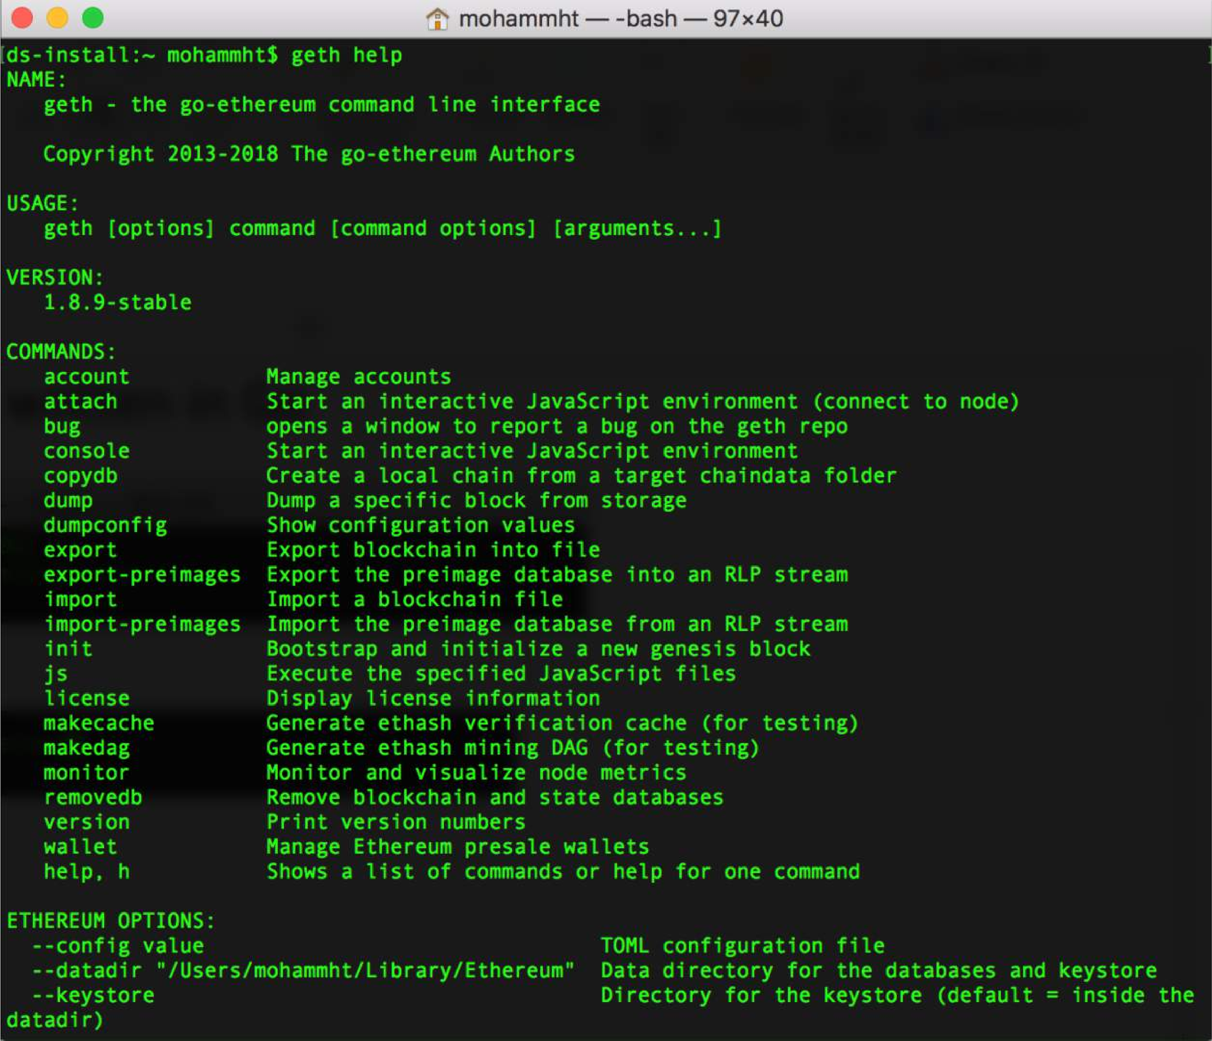
Geth help

Slide 51
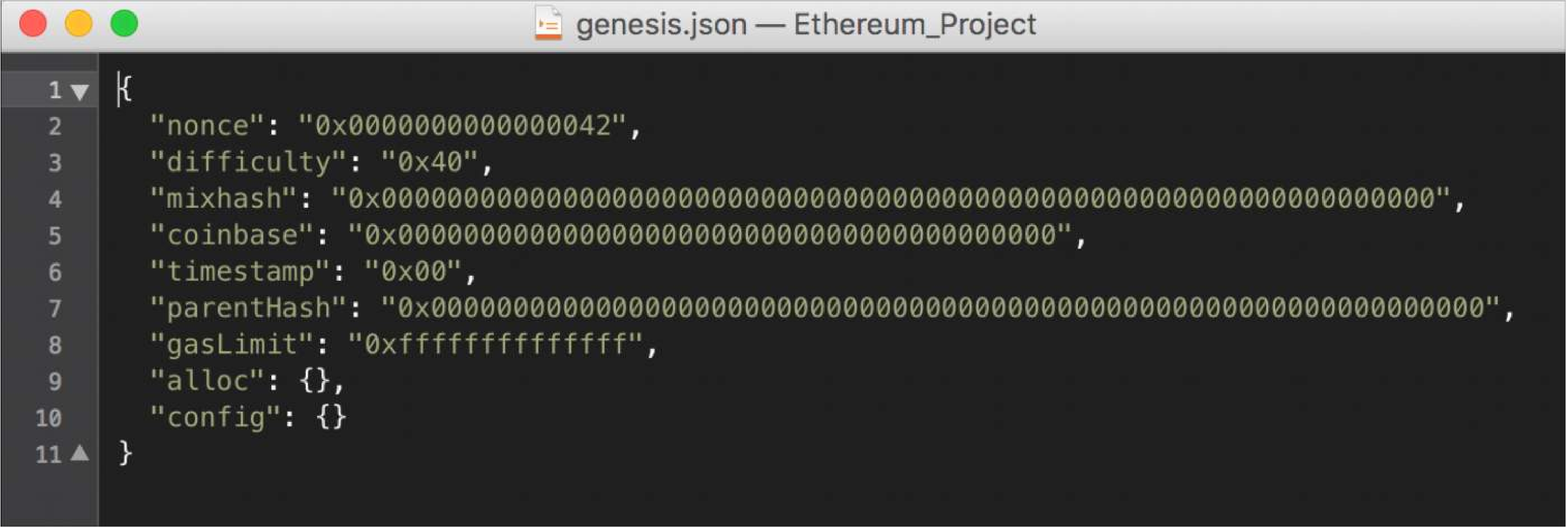
Genesis block
The first block in the chain and a json file that stores the configuration of the chain
Create and store the file as genesis.json

Slide 52

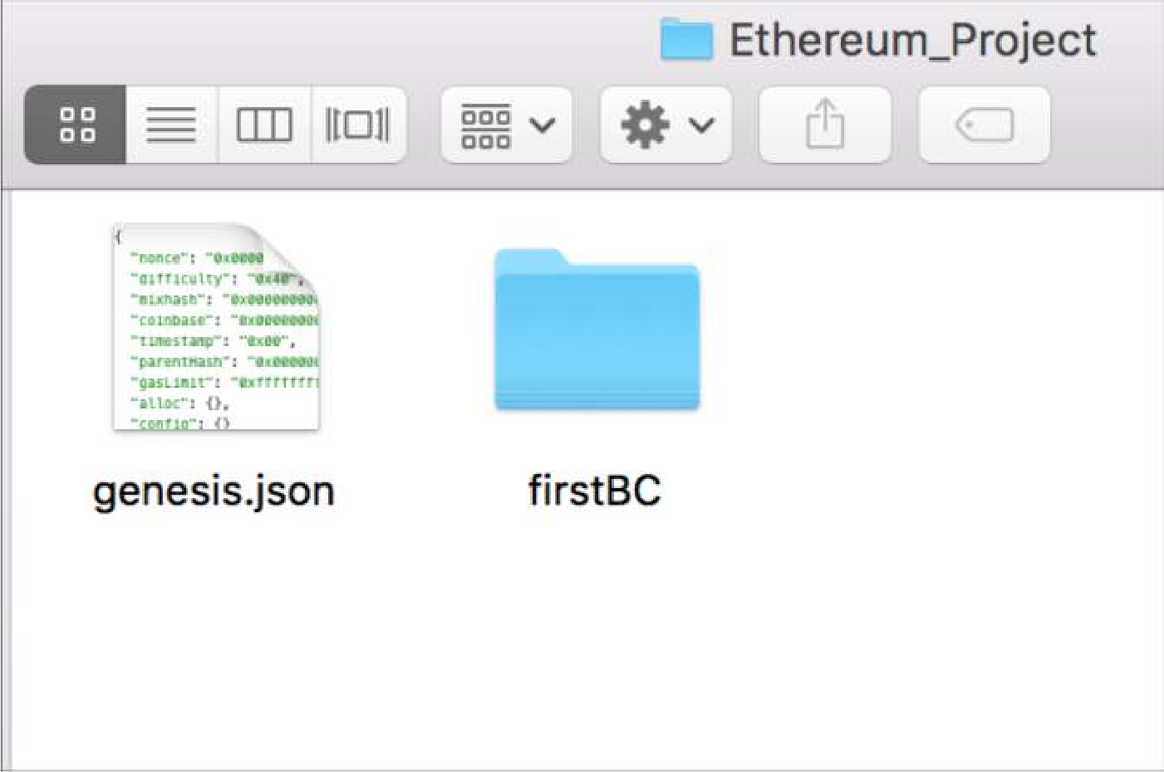
Create the storage of the blockchain
Go to the directory of the genesis.json file
Specify directory of your blockchain
Create the storage from the genesis block
Folder name of your blockchain

Slide 53

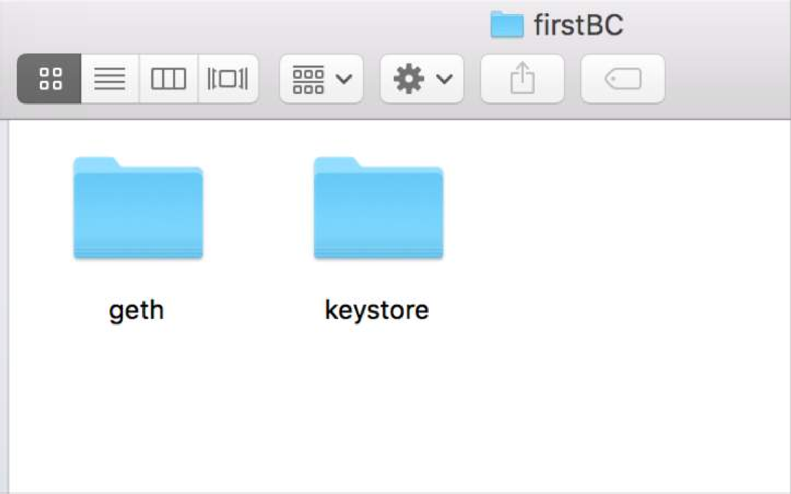
Inside the Blockchain Folder
geth folder: Store your database
keystore: Store your Ethereum accounts

Slide 54
Start the Ethereum peer node
Start the blockchain
Networkid provides privacy for your network.
Other peers joining your network must use the same networkid.

Slide 55
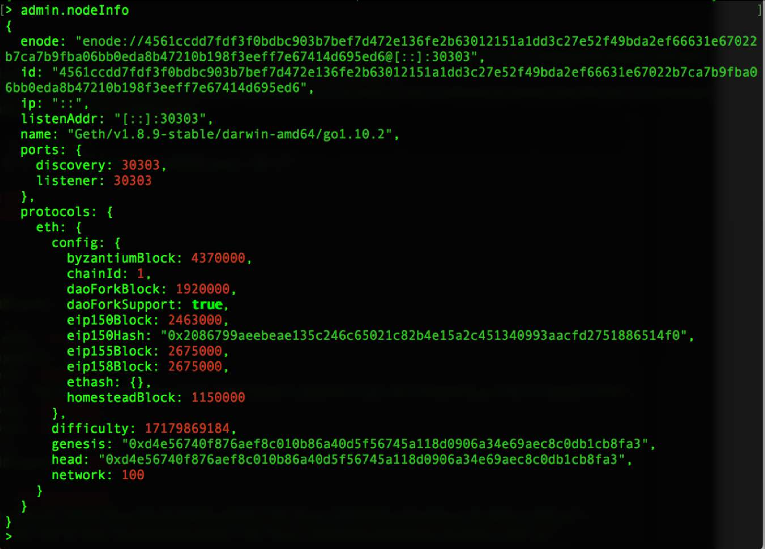
Blockchain started
Type admin.nodeInfo to get the information about your current node

Slide 56
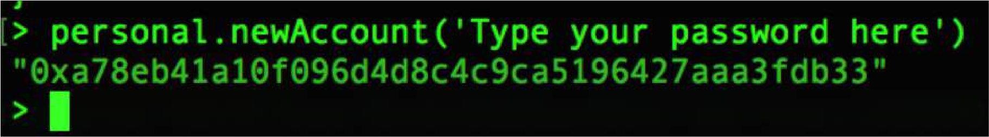
Create an account
Type personal.newAccount to create as many accounts as you need
See the created account(s)

Slide 57
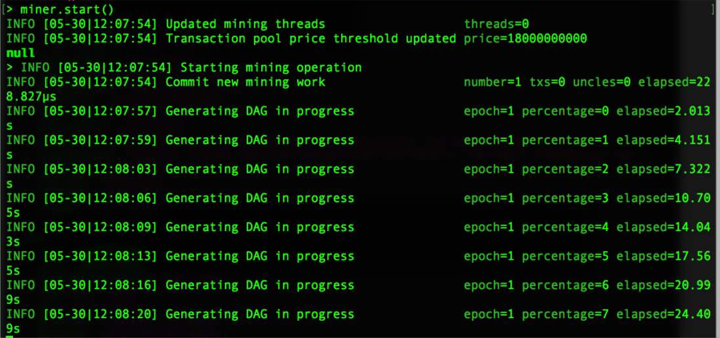
Mining
Type miner.start() to start mining
Type miner.stop() to stop mining

Slide 58
Thank You!

